Slide 1
Single-Mode VCSEL with Zn-Diffusion Apertures and Strong Immunity Against Optical Feedback for Improved Data Transmission
Speaker :Prof. Jin-Wei Shi
Notes:
各位口委大家好，我是吳旻龍。我今天要報告的主題是

Slide 2
Acknowledgement
Students: Dr. Zuhaib Khan, Cheng-Wei Lin
Notes:
首先，要感謝中央大學電機系及微光電實驗室
也要感謝合作公司
以及我們實驗室一起努力的組員們

Slide 3
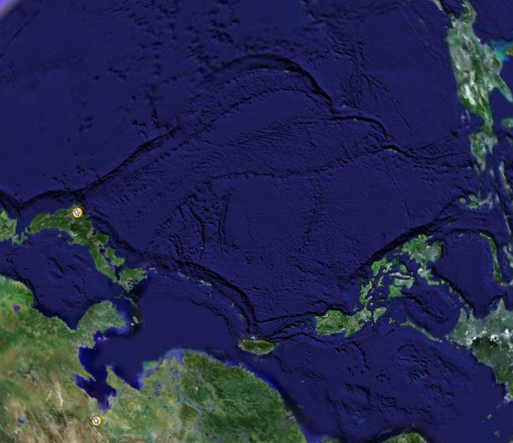
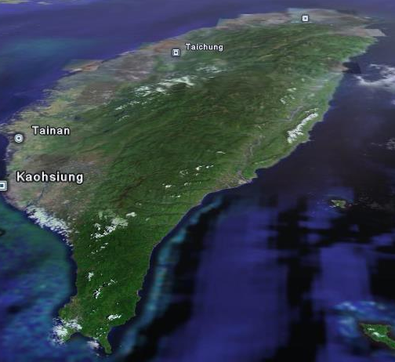
From where we
come from?
NCU Taiwan

Slide 4
Outline
Introduction & Motivation
Challenge for single-mode VCSEL
Device structure and measurement result
Conclusion
Notes:
再來講解一下 為了達到衛星通訊及data center的要求，我們該如何設計我們的元件

Slide 5
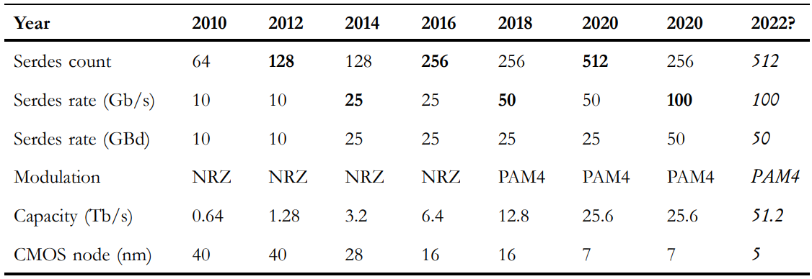
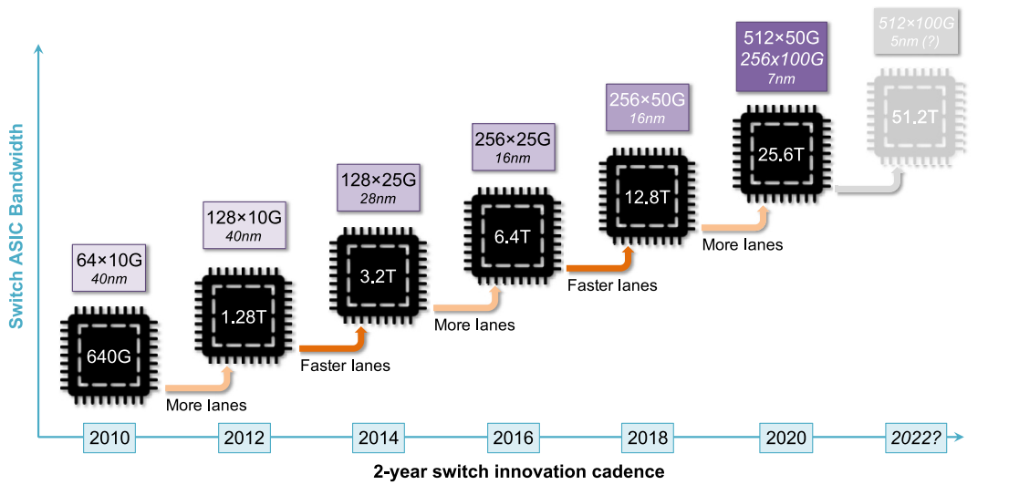
Data rate
Gate length
Cyriel Minkenberg1 | Rajagopal Krishnaswamy 2 | Aaron Zilkie3 | David Nelson, “Co‐packaged datacenter optics: Opportunities and challenges ,” IET optoelectronics Accepted: 16 September 2020
Notes:
AI在進行大規模數據處理和執行複雜計算任務時，需要高頻寬和低延遲的通信。
CPO技術可以提供比Pluggable Optics更高的數據傳輸速度，及更低的損耗從而加速計算和訓練過程。
(按)以及現在元件線寬越做越小，Data rate不斷提升的情況下更需要CPO所提供高速、高容量的光纖通信連接

Slide 6
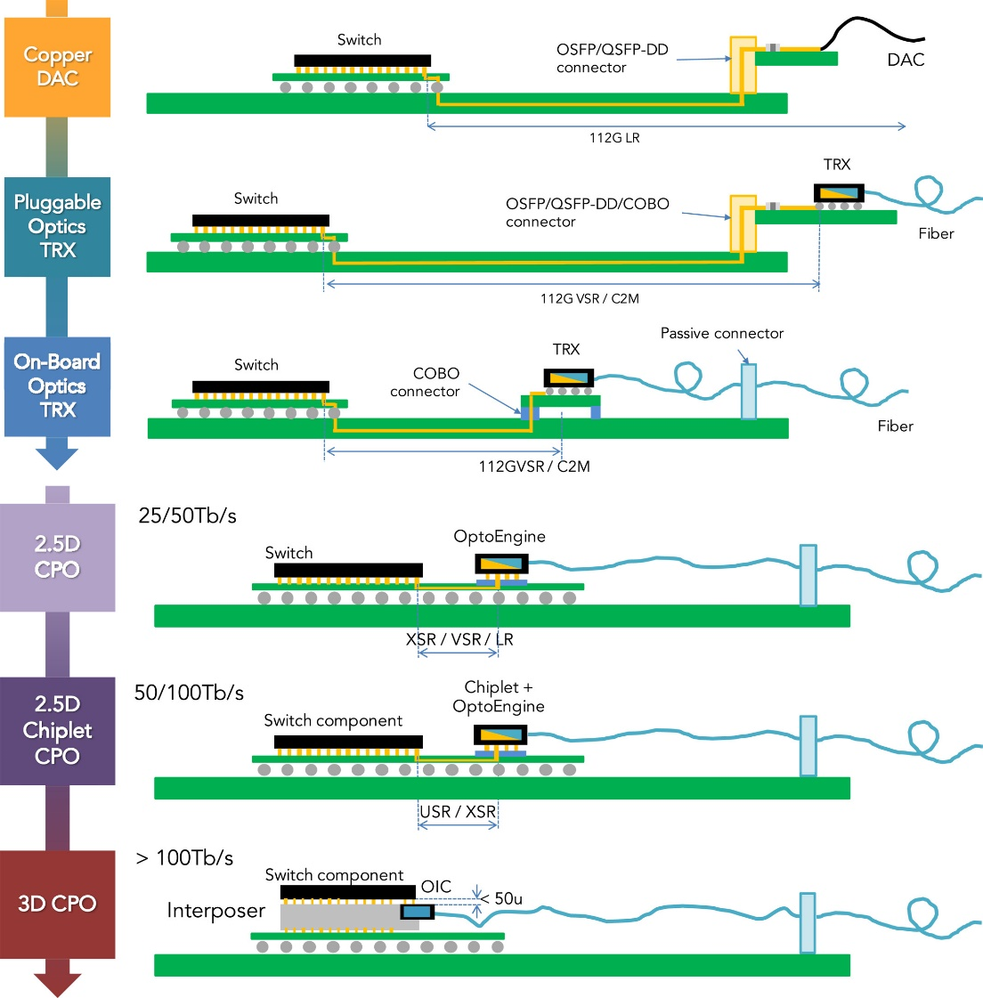
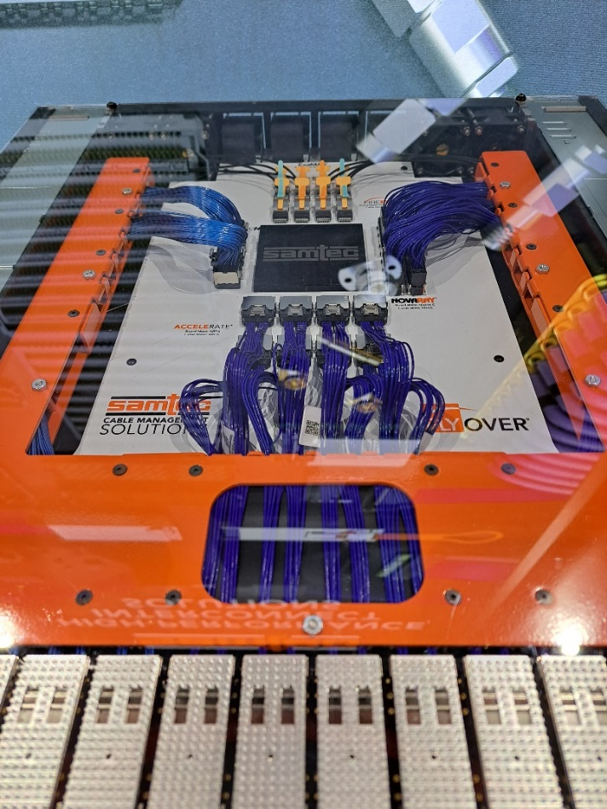
Fiber
CPU
Co-packaged optics(CPO) evolution
CPO product on the market
We need high density packaging

Slide 7
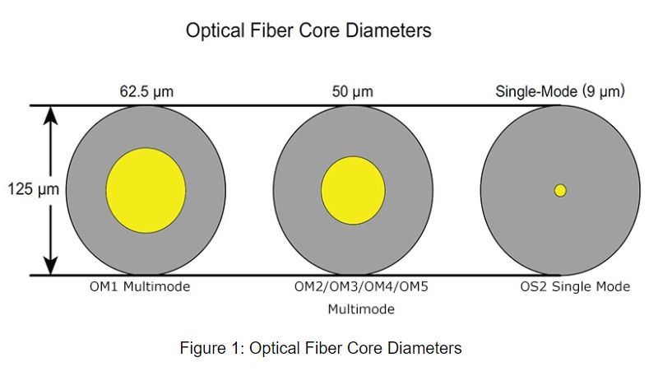
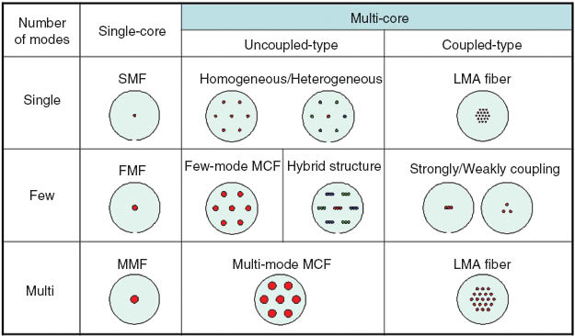
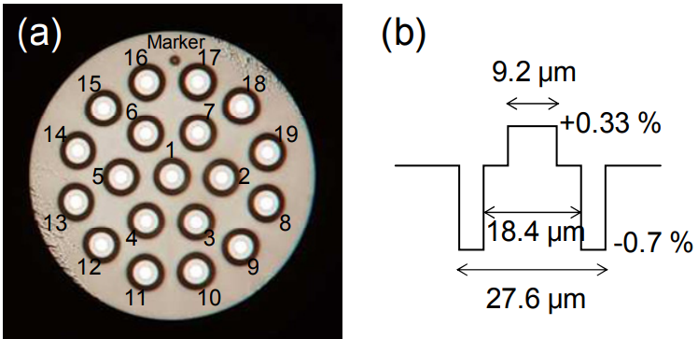
Challenges of MMF
Single-mode fiber and multicore fiber
High density packaging

Slide 8
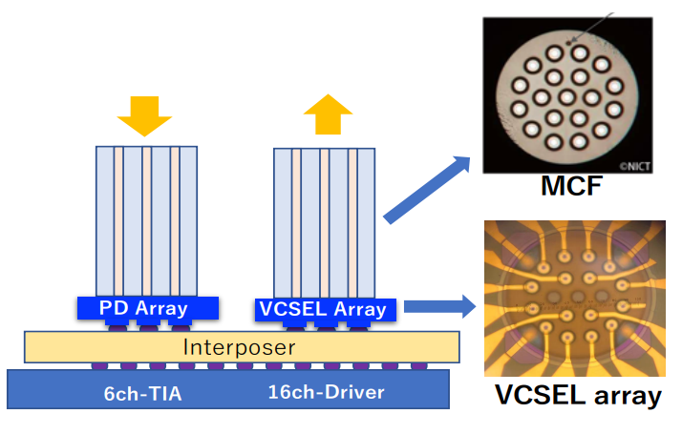
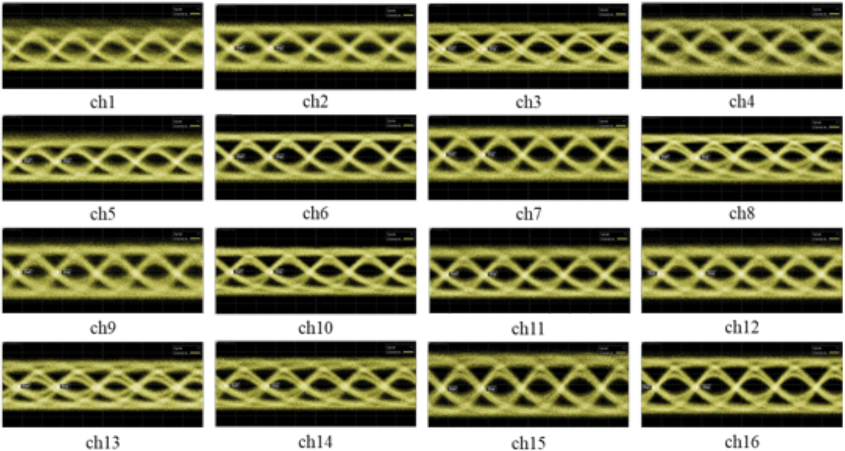
High density packaging
What are the challenges of single mode VCSEL
Single-mode fiber
Single-mode VCSEL
Liang Dong1 , Xiaodong Gu1,2 and Fumio Koyama, “16-ch 1060-nm Single-mode Bottom-emitting Metal-aperture VCSEL Array for Co-packaged Optics,” in OFC 2023 © Optica Publishing Group 2023

Slide 9
Outline
Introduction & Motivation
Challenges for single-mode VCSEL
Device structure and measurement result
Conclusion
Notes:
再來講解一下 為了達到衛星通訊及data center的要求，我們該如何設計我們的元件

Slide 10
How can we attain single mode
Small aperture?

Slide 11
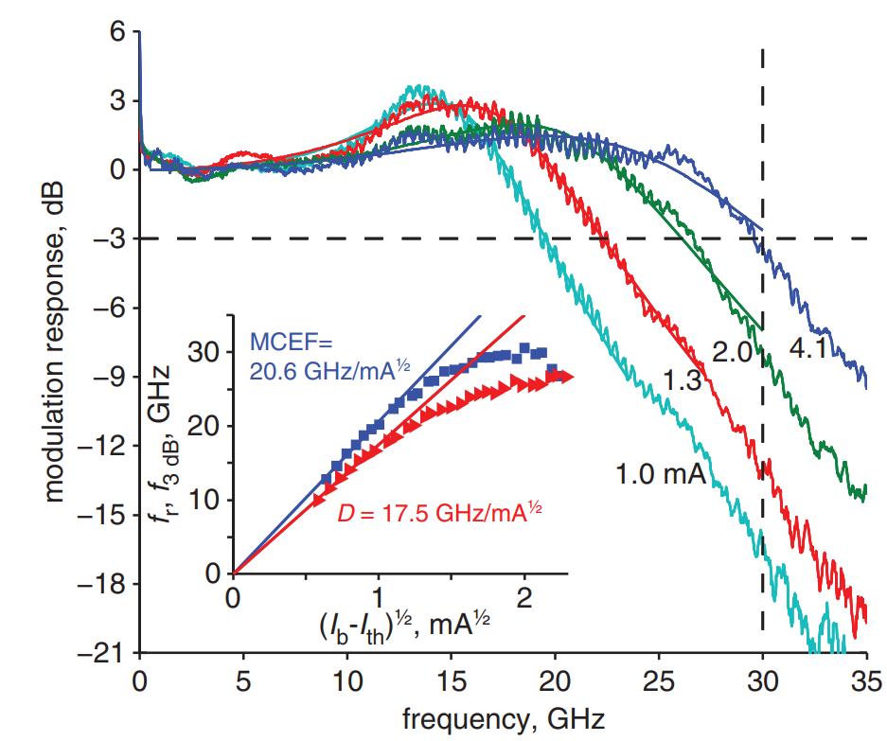
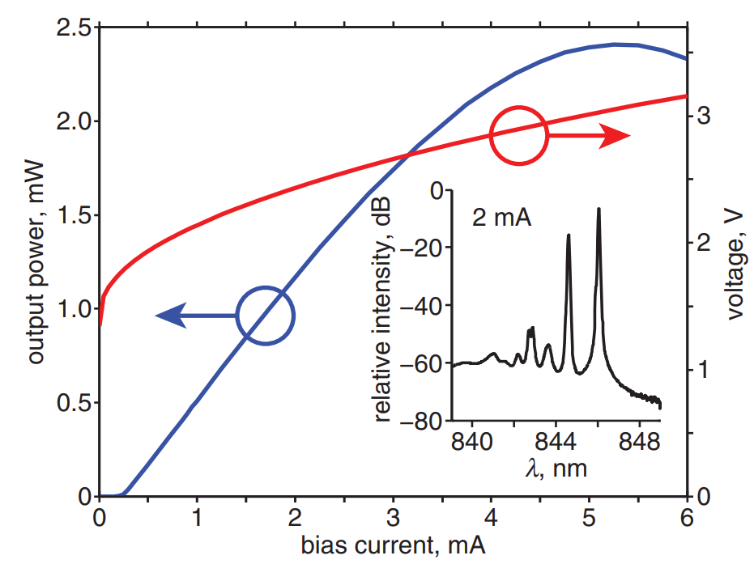
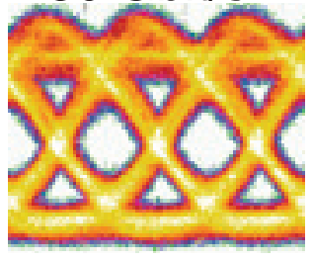
The problem of small aperture
Low output power !! Reliability? (High current density)
Resonance
3.5$μ$m
Overshoot Eye
Any problems
E. Haglund, P. Westbergh, J.S. Gustavsson, E.P. Haglund, A. Larsson, M. Geen and A. Joel, “30 GHz bandwidth 850 nm VCSEL with sub100 fJ/bit energy dissipation at 25–50 Gbit/s,”IET ELECTRONICS LETTERS 9th July 2015 Vol. 51 No. 14 pp. 1096–1098

Slide 12
How can we attain single mode
Large aperture?

Slide 13
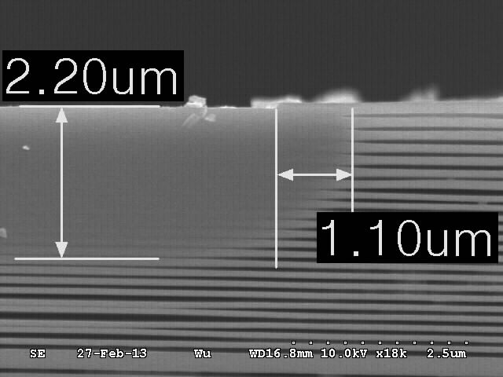
Our approach : Zn diffusion
Reducing number of modes will enhance brightness and reduce divergence angle.
Zinc diffusion
n (Reflectivity)
R ( series resistance)
Disorder
Oxide layer
MQW
C. C. Chen, S. J. Liaw, and Y. J. Yang, “Stable Single-Mode Operation of an 850-nm VCSEL with a Higher Order Mode Absorber Formed by Shallow Zn Diffusion”, IEEE Photon. Technol. Lett., vol. 13, no. 4, Apr. 2001.
Notes:
我們實驗室選擇使用鋅擴散製程來達到單模態
(按)這個是VCSEL最普遍的結構，當我們給元件一個電流，所激發出的雷射光就會形成多膜態。
(按)當我們加入鋅擴散製程，鋅source會破壞上層高反射率的DBR，使反射率下降，(按)不僅能夠有效的抑制模態，甚至能達到單模的效果，另一方面也可以降低電阻值(按)所以我們可以利用降低模態數減少VCSEL的發散角來提升亮度。

Slide 14
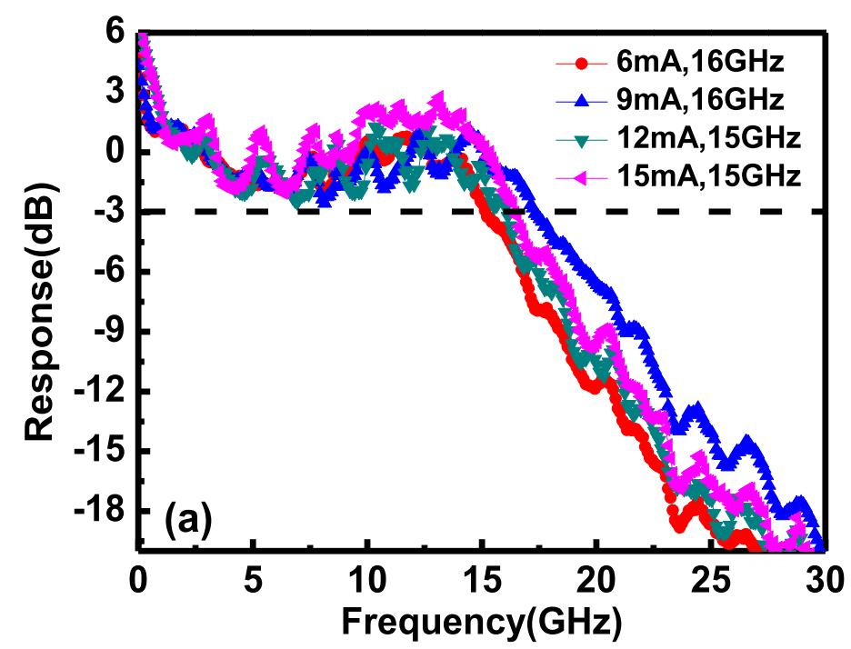
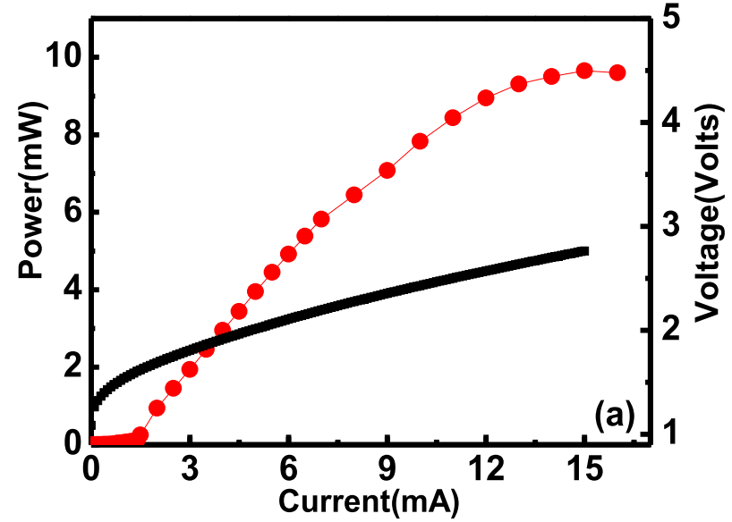
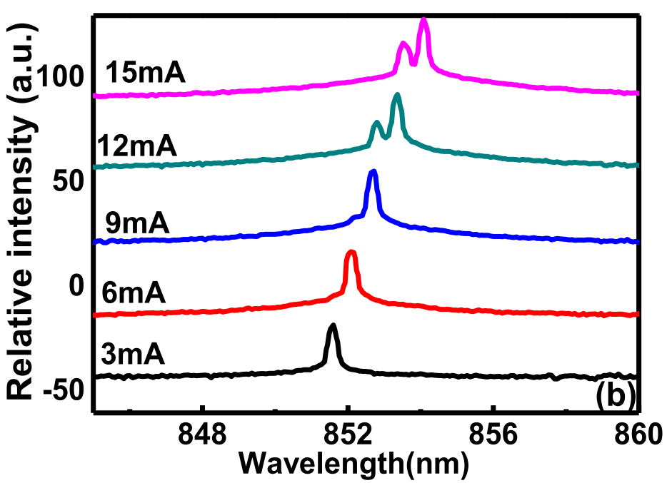
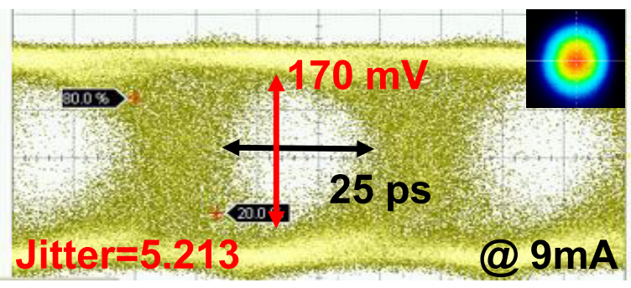
The problem of Large aperture
Low frequency roll off
High Power
Higher RIN value
ZUHAIB KHAN1 , YUNG-HAO CHANG1 , TE-LIEH PAN2 , YAUNG-CHENG ZHAO1 , YEN-YU HUANG1 , CHIA-HUNG LEE3 , JUI-SHENG CHANG3 , CHENG-YI LIU3 , CHENG-YUAN LEE2 , CHAO-YI FANG2 , AND JIN-WEI SHI, “High-Brightness, High-Speed, and Low-Noise VCSEL Arrays for Optical Wireless Communication,” IEEE PHOTONICS SOCIETY SECTION VOLUME 10, 2022 pp.2303-2317

Slide 15
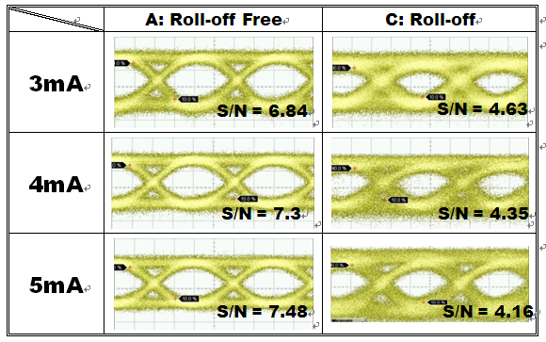
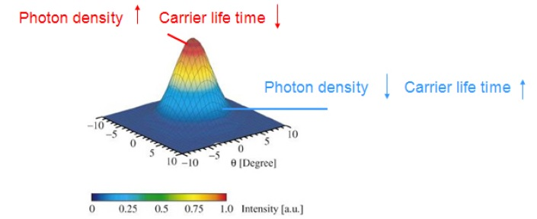
The problem of single-mode Zn Diffusion VCSEL
Spatial hole burning effect (SHB)
Slow hole support
Because of SHB
Trade off between single-mode and data transmission : SHB effect
Fast consumption
Mobility： μ_{electron} ＞μ_{hole}
Low frequency roll-off
A. Haglund, J. S. Gustavsson, P. Modh, Member and A. Larsson, “Dynamic Mode Stability Analysis of Surface Relief VCSELs Under Strong RF Modulation,” IEEE Photon. Technol. Lett., vol. 17, no. 8, pp. 1602-1604, Aug., 2005.
Notes:
除此之外單模態VCSELs通常存在著一個問題：Spatial hole burning effect。
發生的原因是因為當輸入的電流增加使得電子電洞急遽增加，但電洞的mobility比電子小，使電洞來不及補充載子複合速率，故導致功率突然下降的情況。
這個效應會使頻率響應在低頻的時候有roll-off的現象，也會使眼圖劣化

Slide 16
Single-mode issue-sensitive to optical feedback
SM VCSEL is more sensitive to the reflected optical power
SM
MM
Peak
Flat
Ringing
RIN value
SM VS. MM

Slide 17
What’s our solution to get
Single Mode
Non SHB
Higher Output Power
Low Noise
Strong immunity to optical feedback
For future CPO VCSEL?

Slide 18
Outline
Introduction & Motivation
Challenge for single-mode VCSEL
Device structure and measurement result
Conclusion
Notes:
再來講解一下 為了達到衛星通訊及data center的要求，我們該如何設計我們的元件

Slide 19
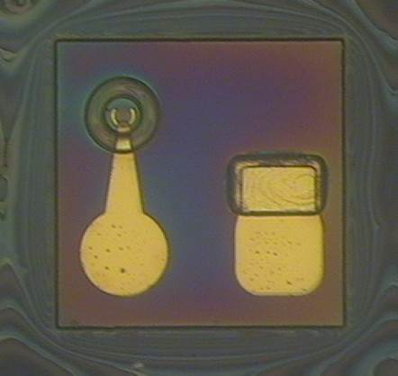
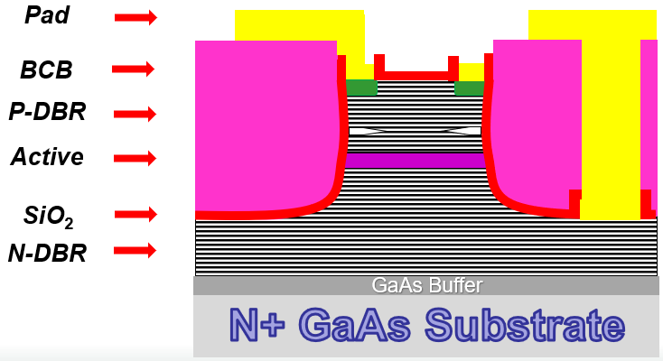
Two different designs
Gen1 (Traditional)
Gen2 (New)
Optimization

Slide 20
LIV
Gen1
Gen2
Non-Diffusion
Gen2
Largest Pmax
Largest SE

Slide 21
BW & Spectrum
Gen1
Gen2
Non-Diffusion
Gen2 wide bandwidth
Gen2 (quasi) single-mode

Slide 22
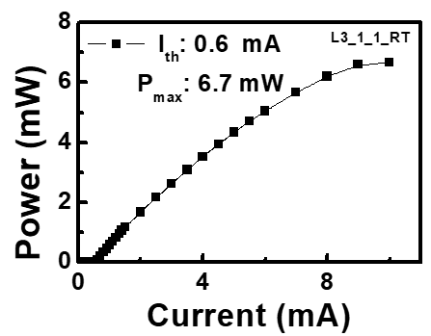
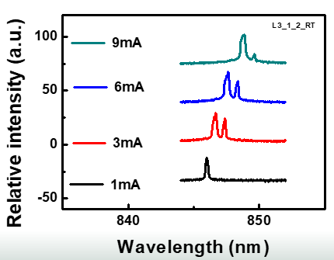
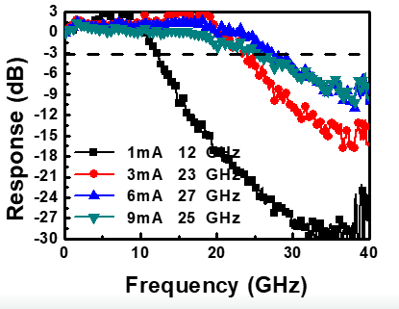
Eliminate SHB issue
Optimization
Higher
Output Power
Solve Low frequency Roll off
Keep Single-mode
Wo
Notes:
於是我們在光場中心加上鋅擴散，利用鋅擴散來稀釋光場中心的光子密度，而達到減緩SHB的效果。

Slide 23
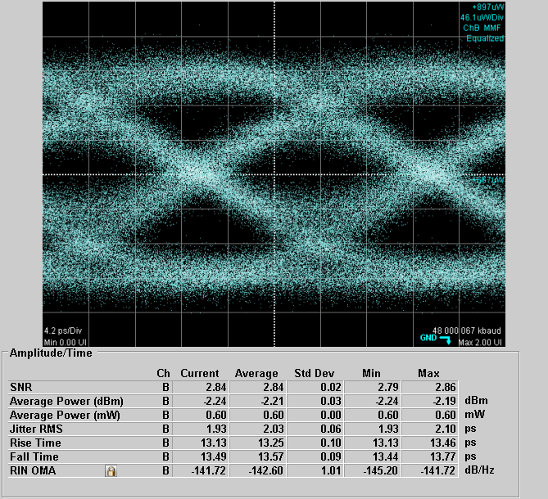
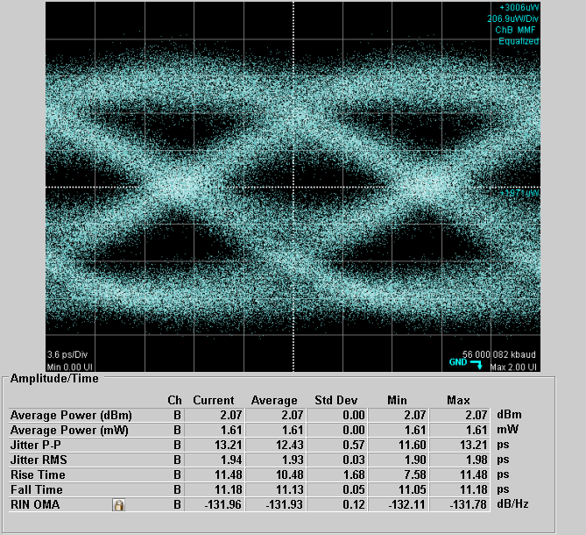
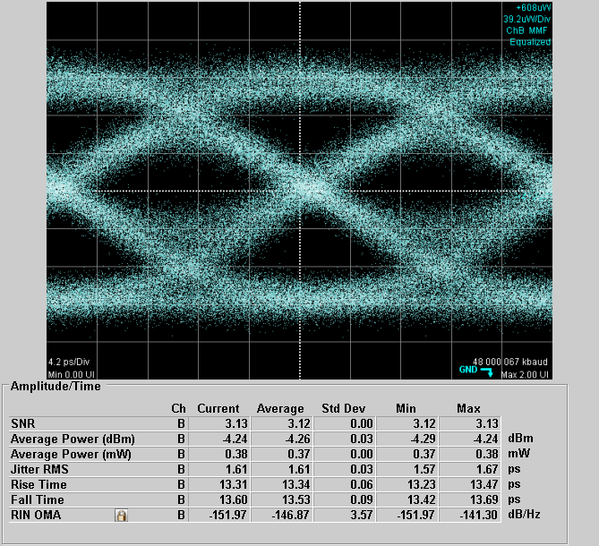
BTB
Gen1
Gen2
Non-Diffusion
Gen2
Best data rate among three
48G
8mA
Jitter:1.9
RIN:-142
56G
8mA
Jitter:1.9
RIN:-132
48G
8mA
Jitter:1.6
RIN:-152

Slide 24
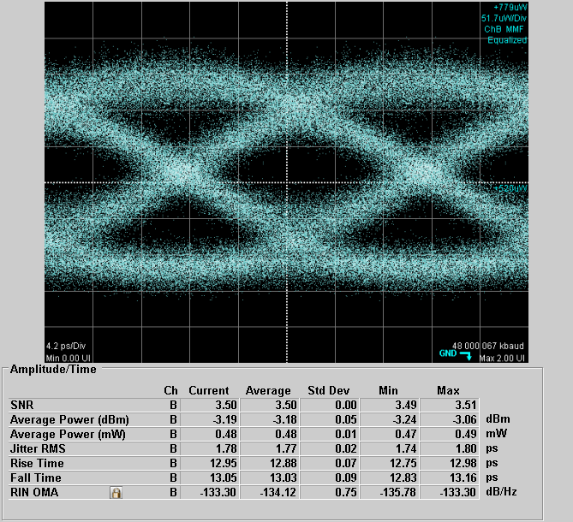
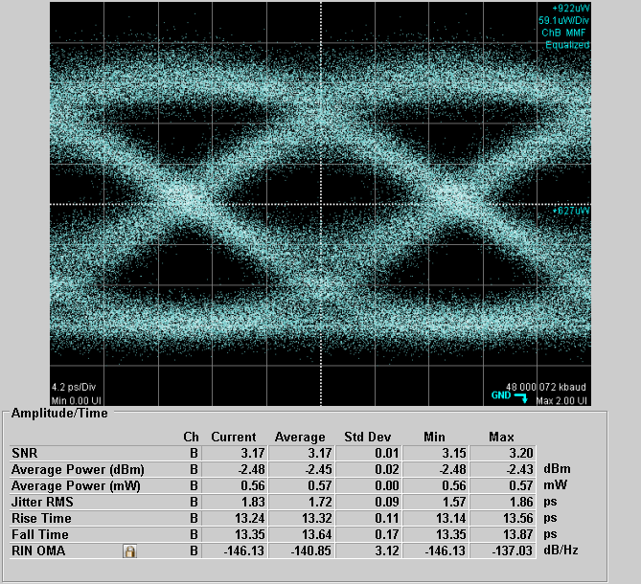
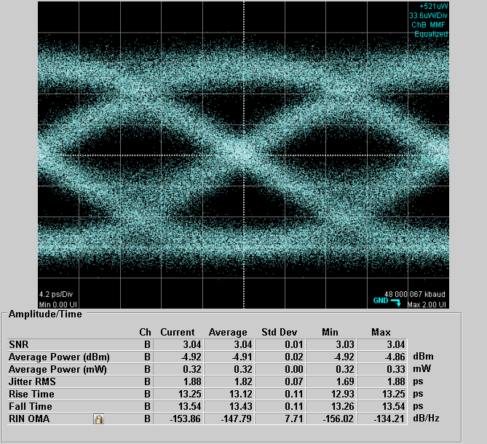
BTB
Gen1
Gen2
Non-Diffusion
Gen2
Lower RIN value at same data rate
48G
8mA
Jitter:1.8
RIN:-133
48G
8mA
Jitter:1.8
RIN:-146
48G
8mA
Jitter:1.9
RIN:-154

Slide 25
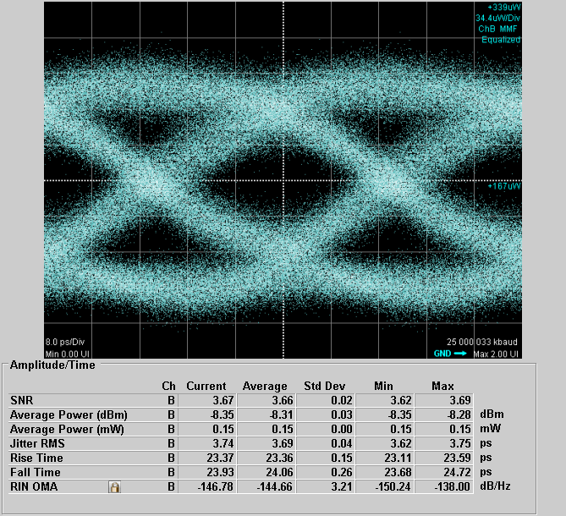
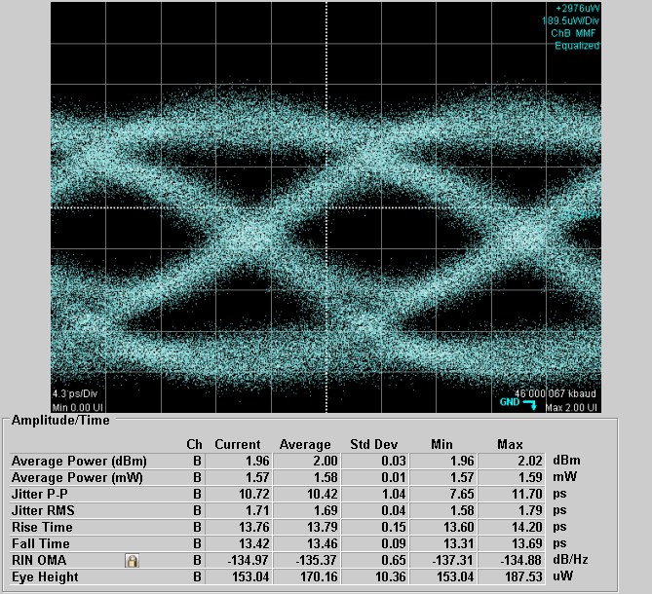
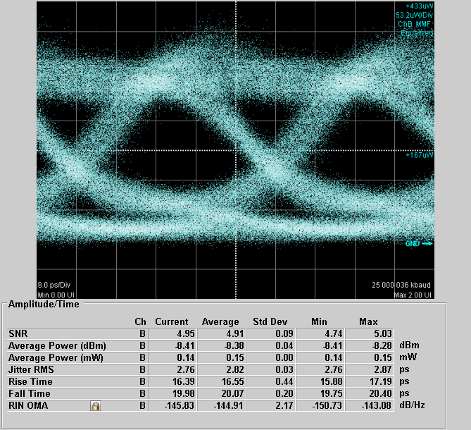
500M
Gen1
Gen2
Non-Diffusion
Gen2
Highest bit rate*distance
25G
3mA
Jitter:3.7
RIN:-147
46G
8mA
Jitter:1.7
RIN:-135
25G
3mA
Jitter:2.8
RIN:-146

Slide 26
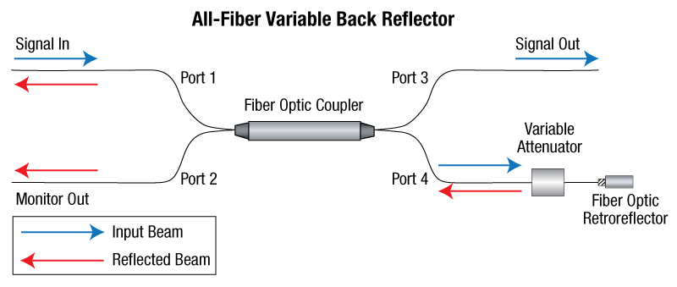
From MMF
0 dBm
3 dBm
To PD
-3 dBm
reflected
0 dBm
0 dBm
reflected

Slide 27
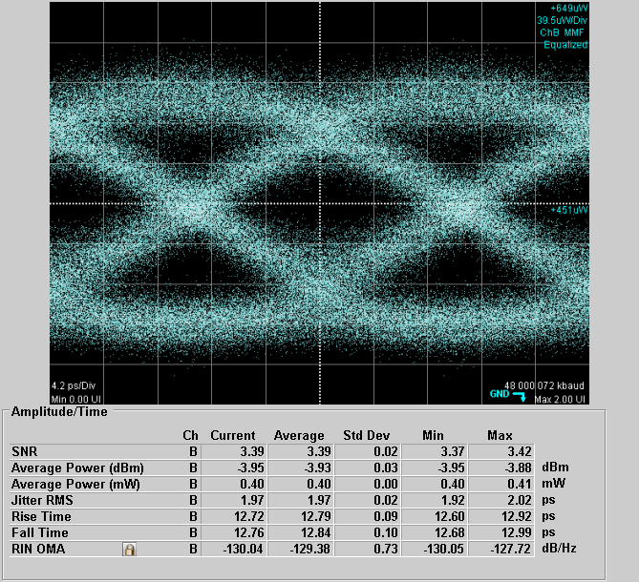
Gen1 RIN OMA under optical feedback
No- Reflection
-12dB
-6dB
Under -6dB reflection
12dB/Hz degradation in RIN OMA
BTB
48G
8mA
Jitter:1.9
RIN:-142
BTB
48G
8mA
Jitter:1.8
RIN:-133
BTB
48G
8mA
Jitter:2.0
RIN:-130

Slide 28
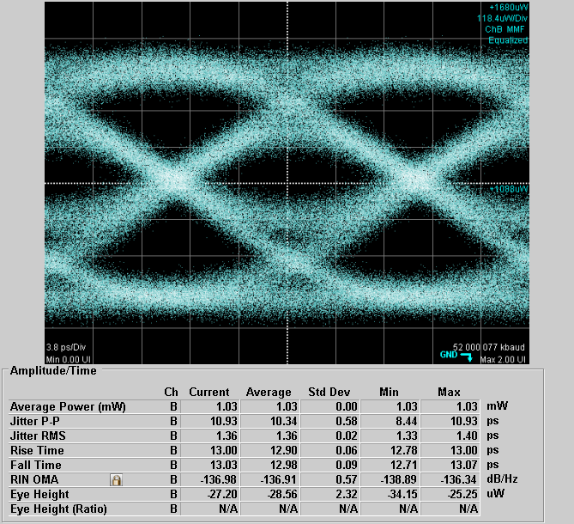
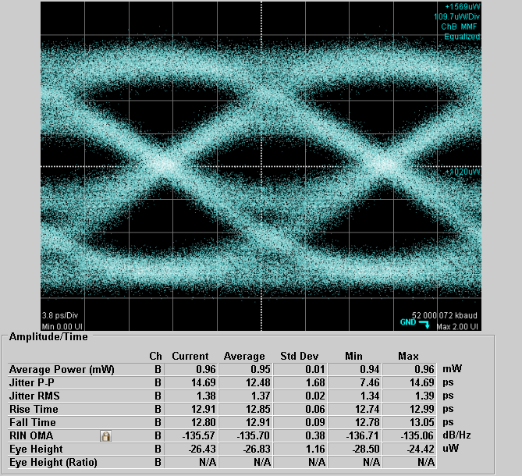
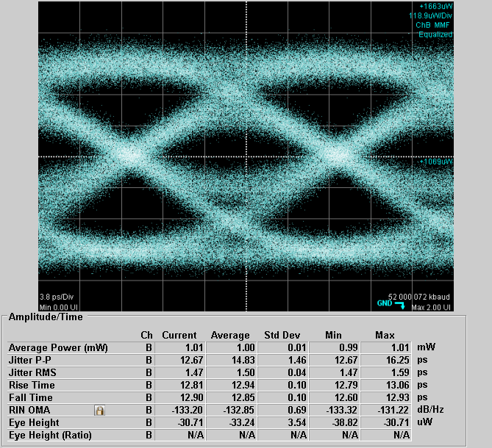
Gen2 RIN OMA under optical feedback
Under -6dB reflection
4dB/Hz degradation in RIN OMA
No- Reflection
-12dB
-6dB
BTB
56G
8mA
Jitter:1.4
RIN:-137
BTB
56G
8mA
Jitter:1.4
RIN:-136
BTB
56G
8mA
Jitter:1.5
RIN:-133

Slide 29
 | Ncu_Gen2 | University of Illinois | Chalmers University of Technology device1 | Chalmers University of Technology device2 | Warsaw University of Technology
Oxide Aperture | 6$μ$m | 4$μ$m | 3.5$μ$m | 8$μ$m
Bias current | 8mA | 6.5mA |  | 13mA | 8mA
BTB Max data rate | 56Gbit/s | 57Gbit/s | 50Gbit/s | 57Gbit/s | 25Gbit/s
MMF (DSP free) Transmission | 500M (46Gbit/s) | 100M (50Gbit/s) |  | 50M (50Gbit/s) | 100M (25Gbit/s)
 |  |  |  | 100M(43Gbit/s)
Bit rate* distance |  | 5000 (M*Gbit/s) |  | 2500(M*Gbit/s) 4300(M*Gbit/s) | 2500 (M*Gbit/s)
23000
(M*Gbit/s)
*G. Stepniak, A. Lewandowski, J.R. Kropp, N.N. Ledentsov, V.A. Shchukin, N. Ledentsov Jr., G. Schaefer, M. Agustin and J.P. Turkiewicz, “54 Gbit/s OOK transmission using single-mode VCSEL up to 2.2 km MMF,” ELECTRONICS LETTERS 14th April 2016 Vol. 52 No. 8 pp. 633–635

Slide 30
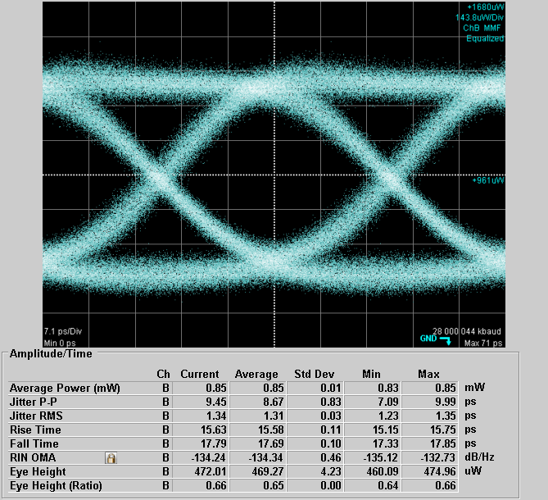
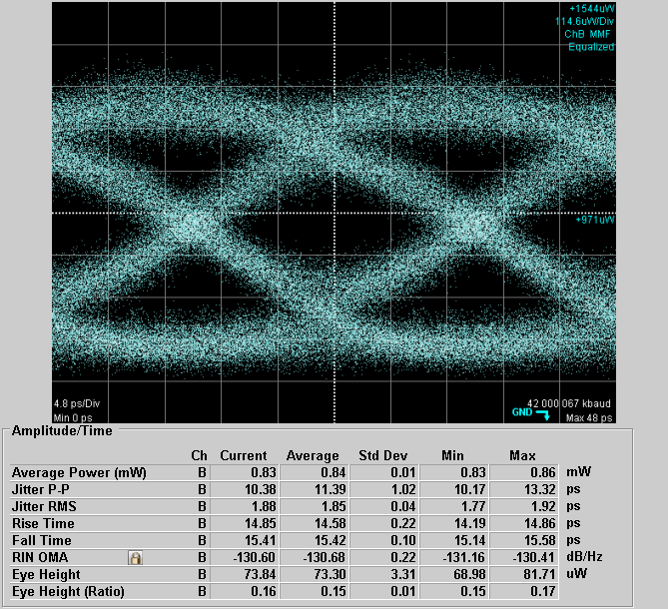
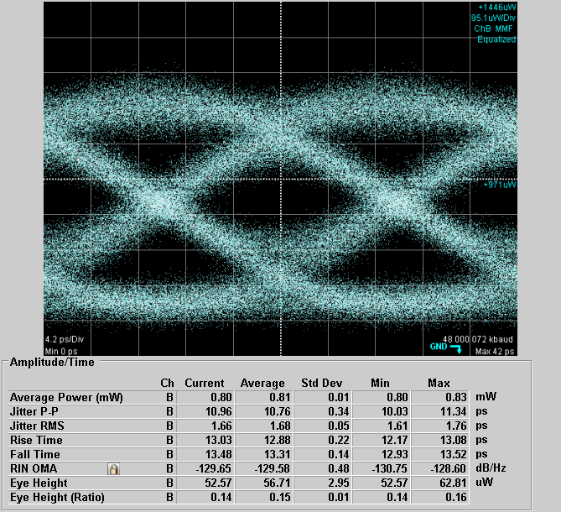
SMF BTB Transmission Results
Ultra SMF provided by corning
~25 % coupling efficiency between VCSEL and fiber
Gen2
(a)
(b)
(c)
28 Gbit/sec
9mA
Jitter:1.34
RIN: -134.2 dB/Hz
42 Gbit/sec
9mA
Jitter:1.88
RIN: -130.6 dB/Hz
48 Gbit/sec
9mA
Jitter:1.66
RIN:-129.7 dB/Hz

Slide 31
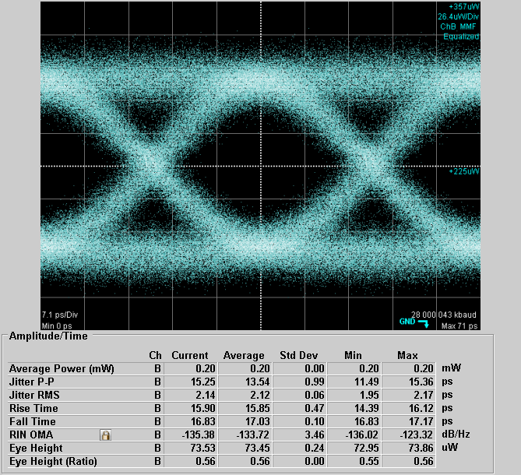
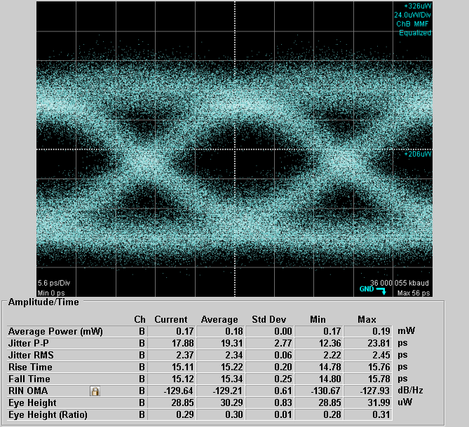
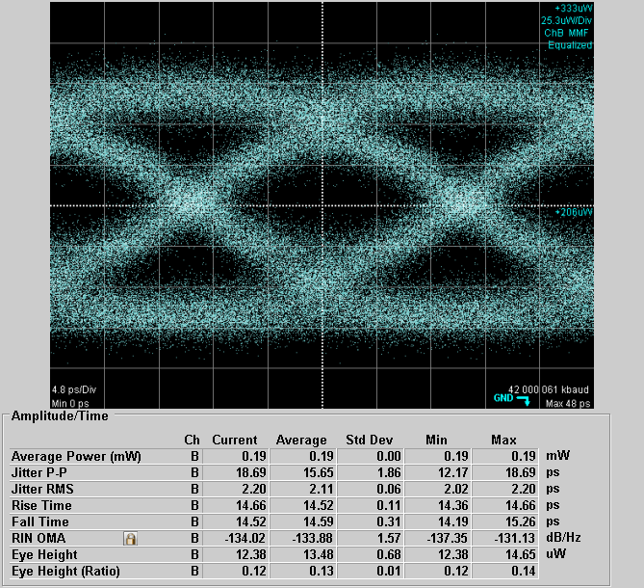
SMF 0.2 km Transmission Results
(a)
(b)
(c)
28 Gbit/sec
Current:9mA
Jitter:2.14
RIN: -135.4 dB/Hz
42 Gbit/sec
Current:9mA
Jitter:2.37
RIN:-129.6 dB/Hz
48 Gbit/sec
Current:9mA
Jitter:2.20
RIN OMA:-134.0 dB/Hz

Slide 32
Outline
Introduction & Motivation
Challenge for single-mode VCSEL
Device structure and measurement result
Conclusion
Notes:
再來講解一下 為了達到衛星通訊及data center的要求，我們該如何設計我們的元件

Slide 33
We demonstrate a novel design of Zn diffusion aperture for VCSEL single device that overcomes the SHB effect.
SM, high-power, and low RIN noise and strong immunity against optical feedback can be achieved simultaneously.
Large bit rate-distance product through MMF and SMF transmission can be achieved simultaneously.

Slide 34
Thank you for your attention

Slide 35
FFP
Gen2
Nearly Gaussian distribution
Gen1
Gen2
Non-Diffusion

Slide 36
RIN OMA measurement
Total noise
Total power
Total bandwidth
RN_{one(el)} | The electrical Random Noise power measured at the one level.
RN_{zero(el)} | The electrical Random Noise power measured at the zero level.
BW_{N} | The noise bandwidth.
MA | The electrical power of the modulation amplitude.

